Slide 1
ANLY 506 Exploratory Data Analysis
Lecture 2: Identifying and Finding What you Need – Planning Your Research

Slide 2
Outline
What research is and is not
The research process
The Research Question or Problem Statement
Sub-Problems

Slide 3
What is research?
Research is not just collecting data or transferring or storing data
Research is a well understood process used to answer a question, resolve a problem, achieve greater understanding, etc. through the systematic gathering of supporting data, conducting of analyses, and formulating and testing answers.
When finished research provides the answer to specific questions or resolutions to specified problems with known levels of confidence.

Slide 4
The overall research process
Step 1: specifying a question or problem including how the answer or resolution will be known
Step 2: specifying the research methodology or path that the research will follow
Step 3: Keeping the research on track by adhering to the specified research question
Step 4: Gathering and analyzing appropriate data to find answers and levels of confidence in those answers

Slide 5
Step 1. Specify a question or Problem
There are questions and problems everywhere
General questions or problems can spark imagination and ignite the research process
General questions or problems are not sufficient to conduct a research project

Slide 6
Step 2. Specify Research methodology
A research project follows a prescribed methodology
A research project includes all appropriate standards
A research project has explicit assumptions
And those assumptions play a role in validation

Slide 7
Step 3. Keep the research on track
Research projects are focused
The heart of a research project is the research question or problem statement
Everything done in conducting the research project is focused on that specified research question or problem statement

Slide 8
Step 4. Data, data, data
Data is a critical element in a research project
In performing analyses
In finding answers
Opinions are important but by themselves do not form the answers to research questions

Slide 9
The research cycle
Research begins with a problem, an unanswered question in the mind of the researcher.
Research sees the goal in a clear statement of the question or problem.
Research subdivides the problem into appropriate sub-problems. Each sub-problem seeks guidance through a specific research question or appropriate hypothesis, etc.
Research posits tentative solutions to the problem or problems through appropriate analytical methods including hypotheses. These analytical methods direct the research to the data.
Research looks for data directed by the question or problem. The data are collected and organized.
Research interprets the meaning of the data, which leads to an answer to the question or resolution of the problem.

Slide 10
The problem statement
“The heart of every research project is the problem. It is paramount in importance to the success of the research effort. To see the problem with unwavering clarity and to state it in precise and unmistakable terms is the first requirement in the research process.”
(Leedy, 1997)

Slide 11
Questions that are not really research questions
“The problem of this research is to learn more about the way in which the Panama Canal was built.”
“This research project will compare the increase in the number of women employed over 100 years – from 1870 to 1970 – with the employment of men over the same time span”
Questions that ask about the correlation between two data sets or have yes/no answers, etc are not research questions.

Slide 12
Broad Problem Statements
“The impact of welfare on children’s attitudes.”
“The relationship between Palestrina and the motet. “
“The economics of busing schoolchildren.”
“The retirement plans of adults.”
These are too broad to be used as research questions.

Slide 13
Clearer Problem Statements
1. “What effect does welfare assistance to parents have on the attitudes of their children toward work?”
2. This study will analyze the motets of two adult composers when each was between 50 and 55 years of age. That is, this study will analyze the motets of Giovanni Pierluigi da Palestrina (1525?-1594) written between 1575 and 1580 to discover their contrapuntal characteristics and will contrast them with the motets of his contemporary William Byrd (1542?-1623) written between 1592 and 1597.

Slide 14
Clearer Problem Statements (cOnt.)
3. “What factors must be evaluated and what are the relative weights of those several factors in constructing a formula for estimating the cost of busing children in a Midwestern metropolitan school system?”
4. How do retirement plans for adults compare with the actual realization, in retirement, of those plans in terms of self-satisfaction and self-adjustment, and what does an analysis of the difference between anticipation and realization reveal for a more intelligent approach to planning?

Slide 15
Our Challenge
How do we get from the preliminary statement of interest in a particular topic to a well formulated research question?

Slide 16
One possible problem statement…
This study proposes to study the science programs in the secondary schools in the United States
For the purpose of… what???

Slide 17
Refining the initial problem statement
This study proposes to study the content of science programs in secondary schools in the Northeast region of the United States in areas where the average annual income is less than the poverty level as defined in 2015.

Slide 18
Questions to ask in refining problem statements
Is the problem stated in a complete, grammatical sentence?
Is it clear how the area of study will be limited/focused?
Does the answer to the problem have the potential for providing important, relevant answers and information?
Will the result be more than a simple exercise in gathering information, answering a yes/no question or making a simple comparison?
Is the problem focused enough to be ‘doable,’ or is it too broad in scope (e.g. attempts to research too much across too large a geographical area or too large a population)?

Slide 19
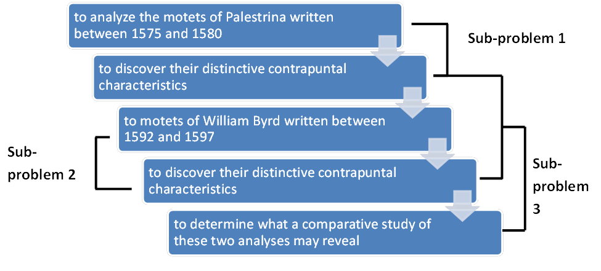
Dividing the problem into sub-problems

Slide 20
Helpful things to keep in mind
Every problem can be further delineated. Every problem should be delineated to the point that the total research project can be successful. In delineating the research every researcher gives full disclosure of all that is intended and of all that is not intended or beyond the scope of the current research project.
All terms used should be fully defined regardless of how common the term might seem. For example, the term complexity is commonly used in research but it means one thing to mathematicians, another to computer scientists and yet another to management/organizational researchers. Fully defining terms helps everyone clearly understand what the research is and what the answer or resolution means when the research is finished.

Slide 21
More helpful things to keep in mind…
All assumptions should be explicitly stated. Do not think that everyone or anyone will understand what you assume. Be clear and concise in stating all assumptions.
Always use a good (as we’ve discussed), complete problem statement.

